Slide 1

Data structure week 0ne
Contact Details:
Email: sobia.iftikhar@nu.edu.pk
GCR:

Slide 2
Distribution of Assessment
Midterm Exam 1: 15 (1 Hour written exam)
Midterm Exam 2: 15 (1 Hour written exam)
Project: 10
Quizzes: 10 (Four Surprise quizzes – best three counted)
Final: 50 (3 Hours Written Exam)

Slide 3
Outline
Recursion
Types of Recursion
Direct In direct Recursion
Tail Non Recursion
Backtracking

Slide 4
Data structures
A data structure is a (often non-obvious) way to organize information to enable efficient computation over that information
A data structure supports certain operations, each with a:
Meaning: what does the operation do/return
Performance: how efficient is the operation
Examples:
List with operations insert and delete
Stack with operations push and pop

Slide 5
Data structure
Data structure is a particular way of storing and organizing data in a computer so that it can be used efficiently.
A data structure is a special format for organizing and storing data. General data structure types include arrays, files, linked lists, stacks, queues, trees, graphs and so on. Depending on the organization of the elements, data structures are classified into two types:
Linear data structures: Elements are accessed in a sequential order but it is not compulsory to store all elements sequentially. Examples: Linked Lists, Stacks and Queues.
Non – linear data structures: Elements of this data structure are stored/accessed in a non-linear order. Examples: Trees and graphs.

Slide 6
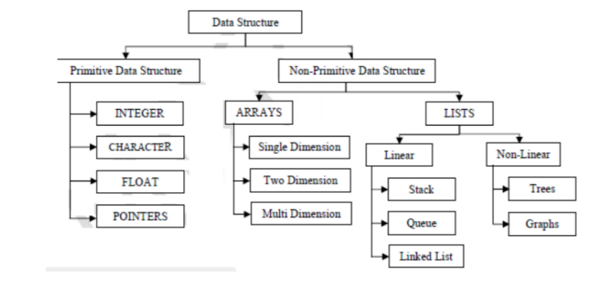
Classification of data Structure
The non­primitive data structures emphasize on structuring a group of homogeneous (same type) or heterogeneous (different type) data items.

Slide 7
Abstract data types
Abstract data types are entities that are the definition of data and operations but don't have implementation.
We know what we are going to storing and we also know what operation we are going to perform, and the way in which data is going to be stored depending upon what data structure we going through.
Why there is no implementation in ADT?
1. REASON IS DIFFERENT PROGRAMING languages.
In c data structure will be implemented using structures concepts
In java followed by classes and objects.
2 ways to look into Data structure
Implementation way
Logical way

Slide 8
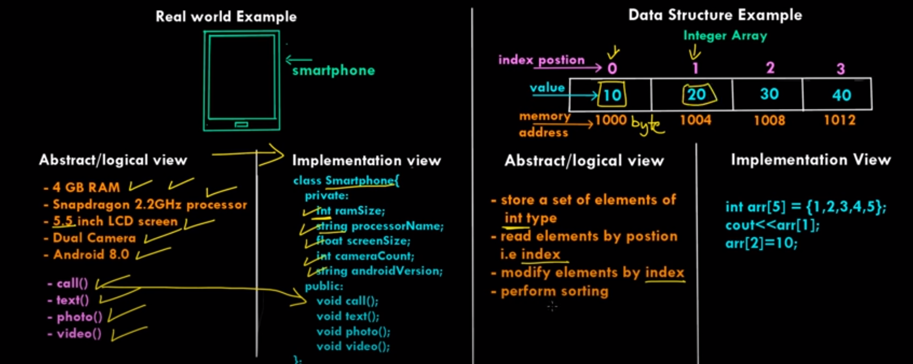
ADT-DATA STRUCTURE EXAMPLE

Slide 9
Different Approaches to Design an Algorithm:
To save time (Time Complexity): A program that runs faster is a better program.
To save space (Space Complexity): A program that saves space over a competing program is 4 considerable desirable.
The time complexity of an algorithm or a program is a function of the running time of the algorithm or a program. In other words, it is the amount of computer time it needs to run to completion
The space complexity of an algorithm or program is a function of the space needed by the algorithm or program to run to completion

Slide 10
Why do we need them?
Requirements for a good software:
Clean Design
Easy maintenance
Reliable (no core dumps)
Easy to use
Fast algorithms
Efficient data structures
Efficient algorithms

Slide 11
Class One

Slide 12
Recursion Example
Write a countDown(int number) method in Java using Recursion which prints countdown till zero to console, like count(3) should print 3 2 1 0.
Write a Java program to calculate the power of a number like power(int number, int power) like power(2, 3) should return 8?

Slide 13
Types of Recursion
Different types of Recursion
Direct
Indirect
Tail
Non Tail

Slide 14
Tail & non-Tail Recursion
Tail Recursion
methodName ( T parameters…){
{
if (base_condition == true)
{
return result;
}
return methodName (T parameters …) //tail recursion
}
Head Recursion
methodName (T parameters…){
if (some_condition == true)
{
return methodName (T parameters…);
}
return result;
}

Slide 15
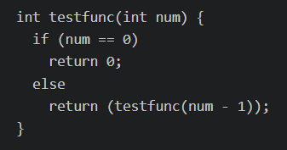
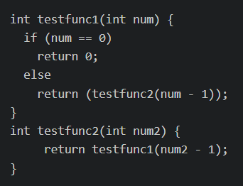
Direct and Indirect Recursion
Direct Recursion
Indirect Recursion

Slide 16
Tail and non tail recursion
int fact(int n) { if (n==0) return 1; else return n*fact(n-1); }
int fact(int n) { if (n==0) return 1; else return n*fact(n-1); }
int fact(int n,value =1) { if (n==0) return value; return fact(n-1,n*value); }

Slide 17
Example 02
Write a recursive function to find the sum of n natural numbers where n >= 1
int sum(int n) { if(n == 1) { return n; } return n + sum(n - 1); } int main() { int n = 4; sop( sum(n)); return 0; }
int sum(int n, int running_sum) { if(n == 1) { return running_sum + 1; } return sum(n - 1, running_sum + n); } int main() { int n = 4; sop (sum(n, 0)); return 0; }

Slide 18
Example 03
int fibonacci(int n, int first, int second) { if(n == 0) { return first; } if(n == 1) { return second; } return fibonacci(n - 1, second, second + first); } int main() { int n = 10; sop( fibonacci(n, 0, 1)); return 0; }

Slide 19
Recursion Application
Tree Traversals
Tree Problems: InOrder, PreOrder PostOrder
Graph Traversals: DFS [Depth First Search] and BFS [Breadth First Search]
Towers of Hanoi
Backtracking Algorithms
Divide and Conquer Algorithms
Dynamic Programming Problems
Merge Sort, Quick Sort
Binary Search
Fibonacci Series, Factorial, etc.

Slide 20
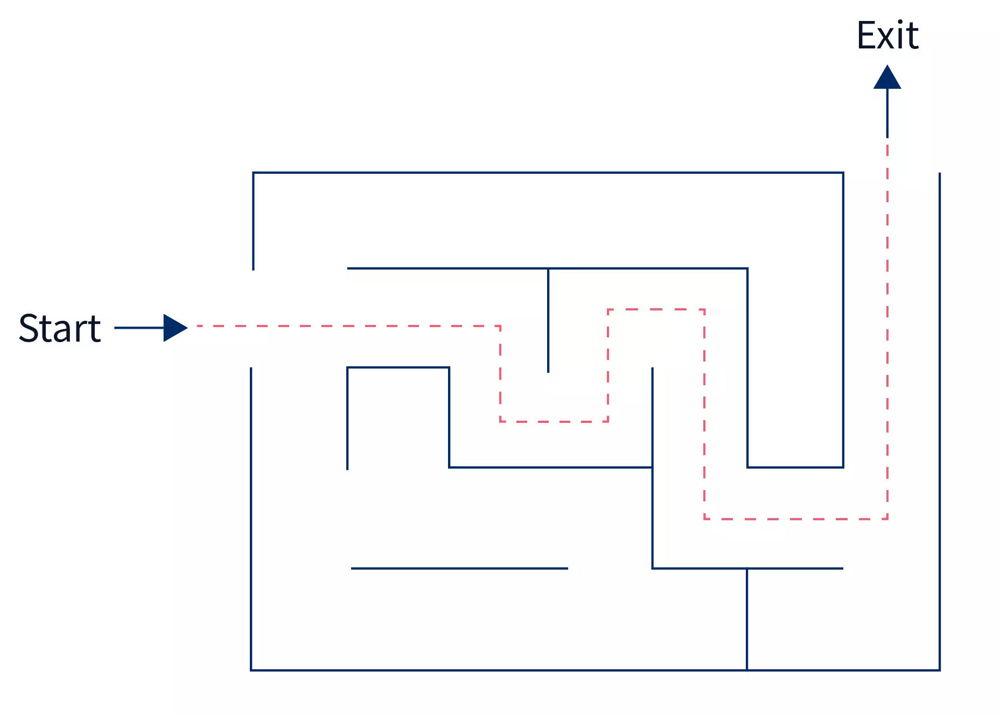
What is backtracking
Case 01:
Think about a scenario where you are standing outside a maze, and you need to find the exit (see image). Now, you have a couple of ways you can try to find the exit door, uncertain of the outcome. You may either run into some wrong path, backtrack(move back to the starting point) and try to find a new path, or one in many chances, you may land into the correct path and reach your exit door. But out of multiple scenarios, you have only one path(marked in green) which will lead you to the exit door.

Slide 21
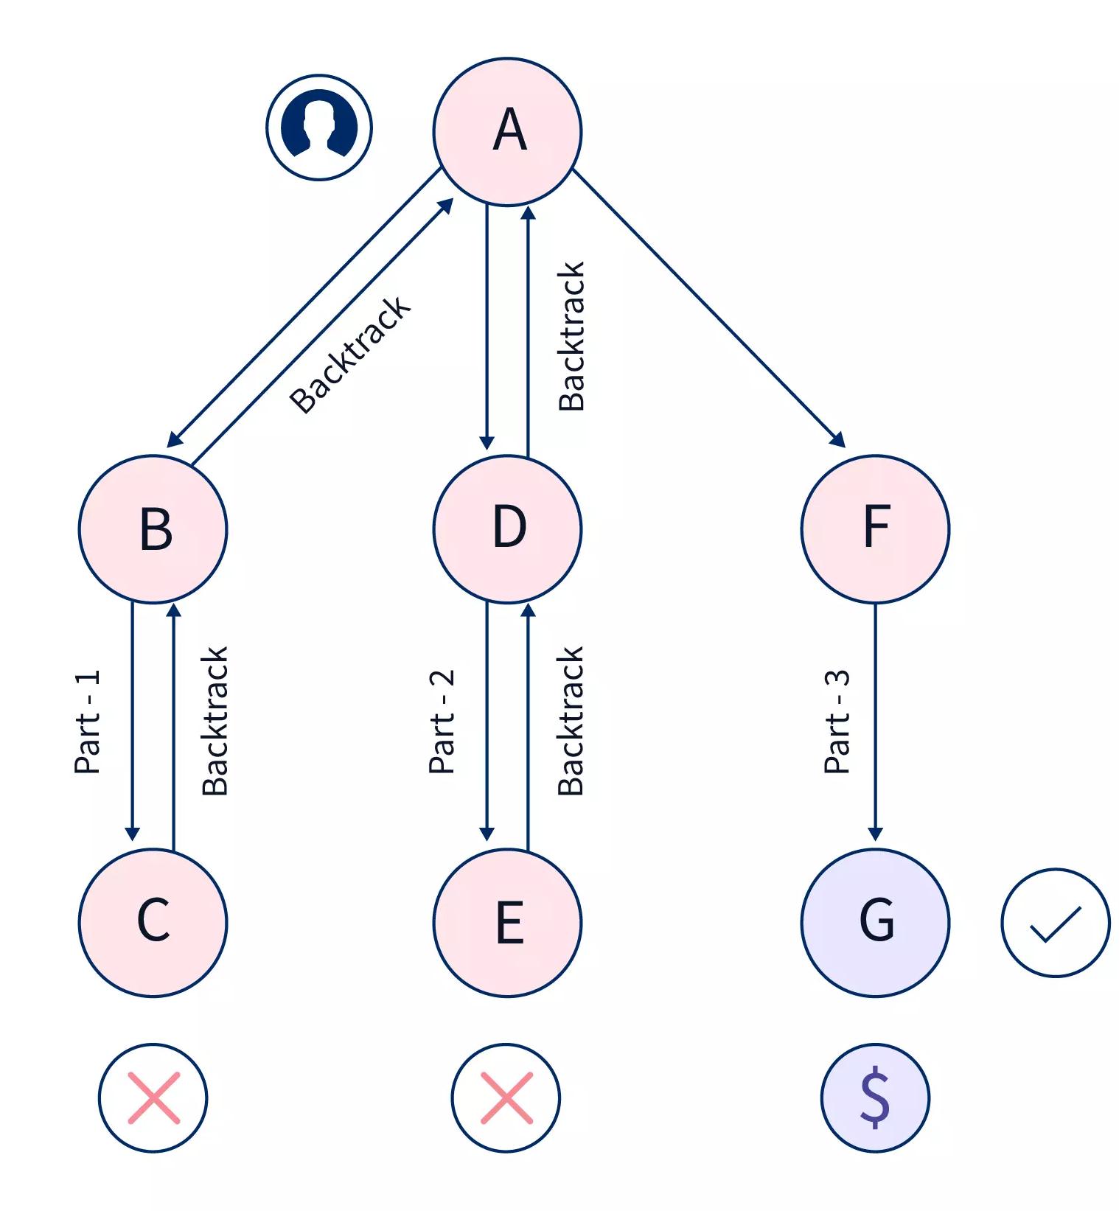
Backtracking Algorithm
For any backtracking problem, the backtracking algorithm tries to go through one of the paths to reach to the possible solution, and if the path doesn't leads them there, then the problem backtracks through the same path and takes another path in search of the solution.
Its kind of increment approach.

Slide 22
Example
There is no major difference between these two in terms of their approach, except for what they do –
Backtracking uses recursion to solve it's problems. It does so by exploring all the possiblities of any problem, unless it finds the best and feasible solution to it.
Recursion occurs when a function calls itself repeatedly to split a problem into smaller sub-problems, until it reaches the base case.
So, we may say recursion is a part of backtracking itself. However, there is no base case in backtracking to stop it. The backtracking mechanism will not stop as long as it finds an optimal solution to the problem.

Slide 23
Example
To solve the N Queen problem.
Rat in Maze solving problem.
Sudoku problem

Slide 24
Recursion vs Backtracking
Recursion is useful in solving problems which can be broken down into smaller problems of the same kind.
Bactraking: while solving a problem using recursion, we break the given problem into smaller ones
Let's take a situation. Suppose you are standing in front of three tunnels, one of which is having a bag of gold at its end, but you don't know which one. So you'll try all three. First go in tunnel 1, if that is not the one, then come out of it, and go into tunnel 2, and again if that is not the one, come out of it and go into tunnel 3. So basically in backtracking we attempt solving a subproblem, and if we don't reach the desired solution, then undo whatever we did for solving that subproblem, and try solving another subproblem.

Slide 25
Example
Let's take a standard problem. N-Queens Problem: Given a chess board having N×N cells, we need to place N queens in such a way that no queen is attacked by any other queen. A queen can attack horizontally, vertically and diagonally.
So initially we are having N×N unattacked cells where we need to place N queens. Let's place the first queen at a cell (i,j), so now the number of unattacked cells is reduced, and number of queens to be placed is N−1. Place the next queen at some unattacked cell. This again reduces the number of unattacked cells and number of queens to be placed becomes N−2. Continue doing this, as long as following conditions hold.

Slide 26
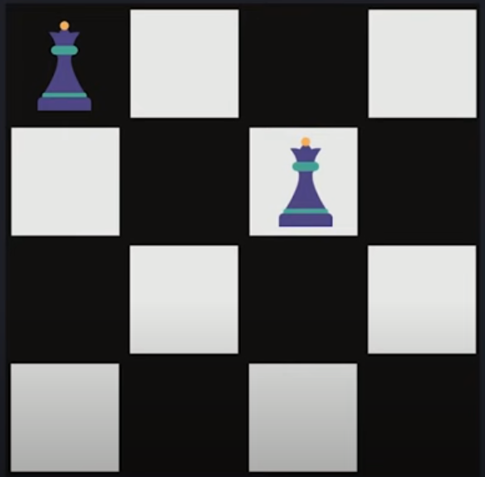
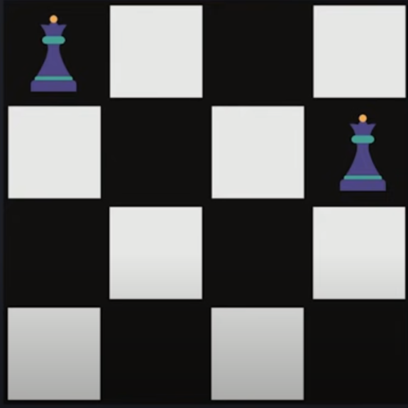
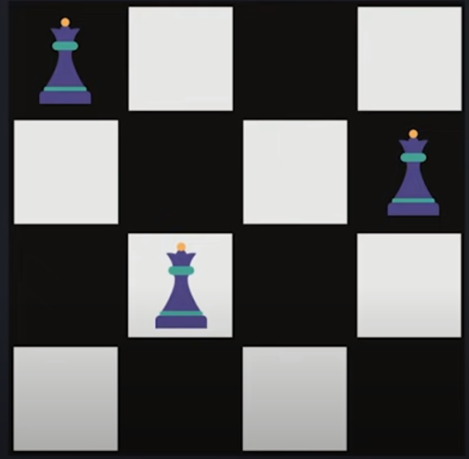
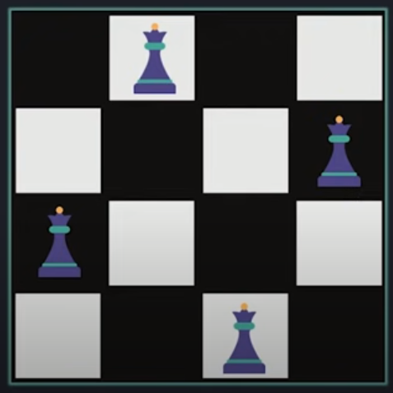
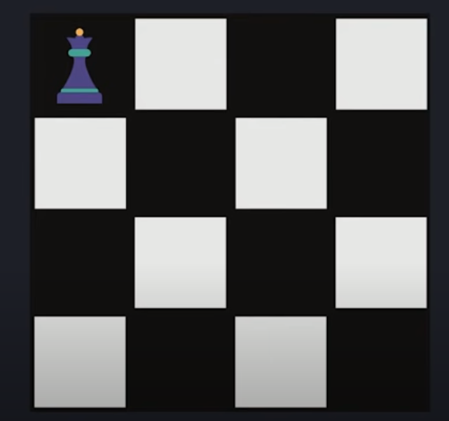

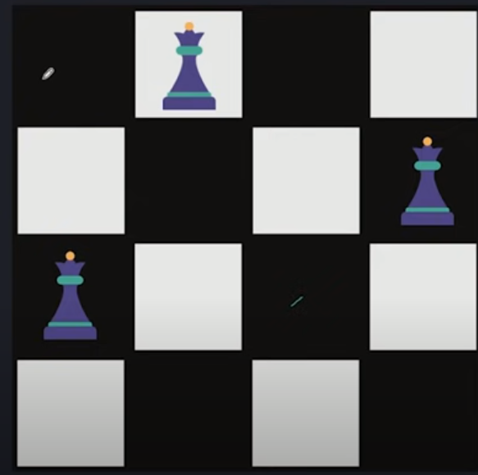
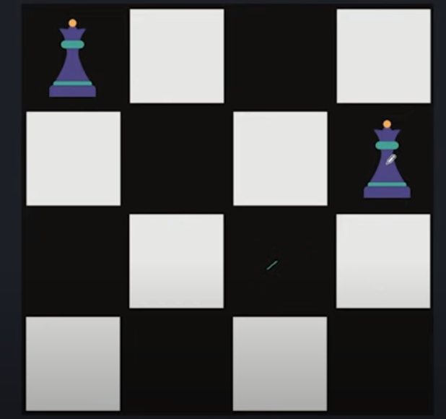
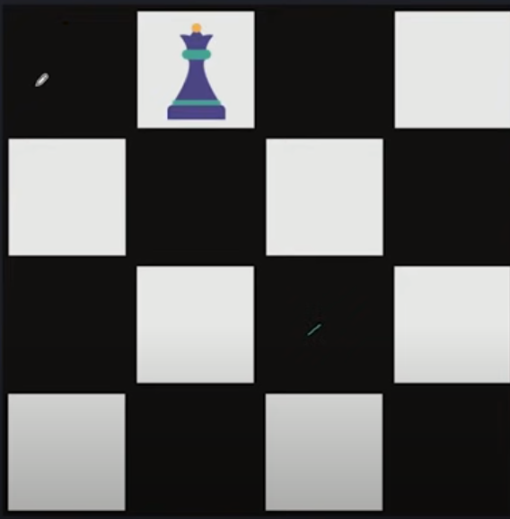
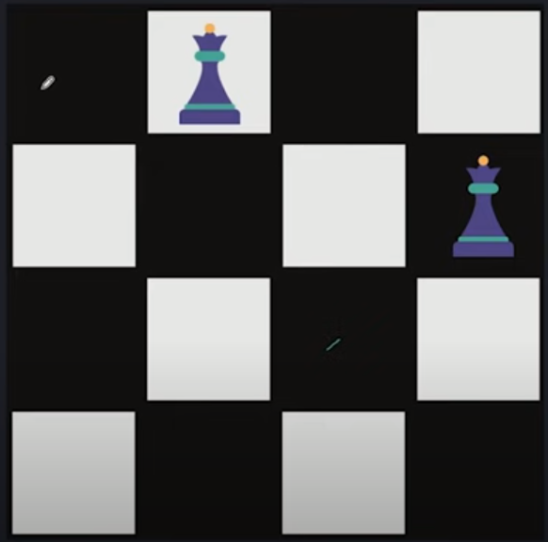
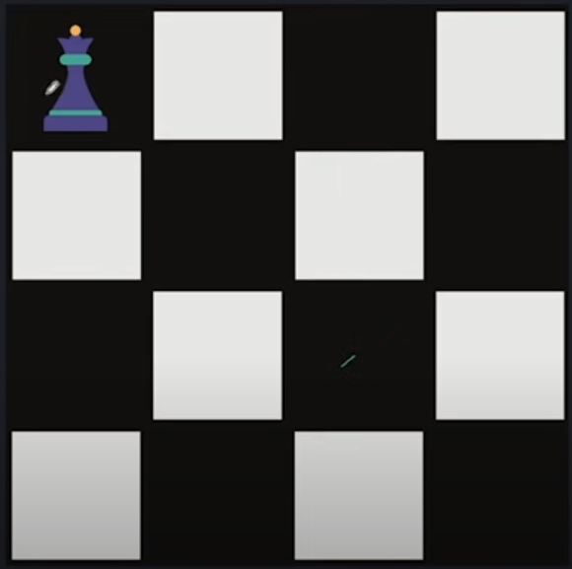
N-Queen Problem

Slide 27
Implementation
public static boolean printNQueens(int[][] chess, int row) {
if (row == chess.length)
return true;
for (int col = 0; col < chess.length; col++) {
if (isQueenSafe(chess, row, col) == true) {
chess[row][col] = 1;
if(printNQueens(chess, row + 1))
return true;
chess[row][col] = 0;
}
}
return false;}
public class Example {
public static void main(String[] args)
BufferedReader br = new BufferedReader
(new InputStreamReader(System.in));
int n = Integer.parseInt(br.readLine());
int[][] chess = new int[n][n];
if( printNQueens(chess, 0) == false){
System.out.println("No Solution");
}
printSolution(chess,n);
}
public static boolean isQueenSafe(int[][] chess, int row, int col) {
for (int i = row - 1, j = col - 1; i >= 0 && j >= 0; i--, j--) {
if (chess[i][j] == 1) {
return false;
}
}
for (int i = row - 1, j = col; i >= 0; i--) {
if (chess[i][j] == 1) {
return false;
}
}
for (int i = row - 1, j = col + 1; i >= 0 && j < chess.length; i--, j++) {
if (chess[i][j] == 1) {
return false;
}
}
return true;
}}
public static void printSolution(int[][] chess,int n){
for(int i = 0; i < n; i++){
for(int j = 0; j < n; j++)
System.out.print(" " + chess[i][j] + " ");
System.out.println();
}
}

Slide 28
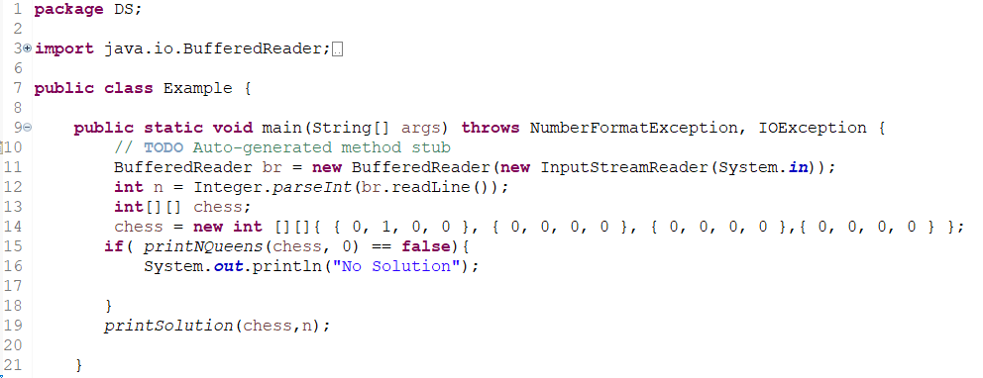
Backtracking Example

Slide 29
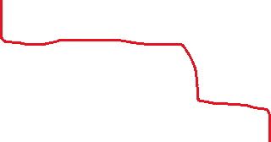

Rate in maze
1 | 0 | 1 | 0 | 1
1 | 1 | 1 | 1 | 1
0 | 1 | 0 | 1 | 0
1 | 0 | 0 | 1 | 1
1 | 1 | 1 | 0 | 1

Slide 30
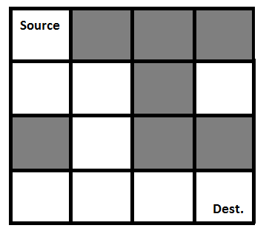
Rate in maze
{1, 0, 0, 0}
{1, 1, 0, 0}
{0, 1, 0, 0}
{0, 1, 1, 1}

